Slide 1
On the Cutting Edge with Nodes: Graph Tables in SQL Server 2017 (and Azure SQL Database)
Sven Aelterman
Director of IT, Sorrell College of Business
Cloud Software Architect, Sorrell Solutions, L.L.C.

Slide 2

Meet Your Speaker

Slide 3




Meet Your Speaker
2012
2018

Slide 4
Opening Question
Using SQL Server 2017?

Slide 5


Overview
Graph Concepts
Usage Example
SQL Server Extension
Star-struck DB

Slide 6
Our sample network

Slide 7
Solution with Traditional Entity Model

Slide 8
Solution with Graph Model

Slide 9
Demo: StarStruck
Movies, actors, roles, and awards!

Slide 10
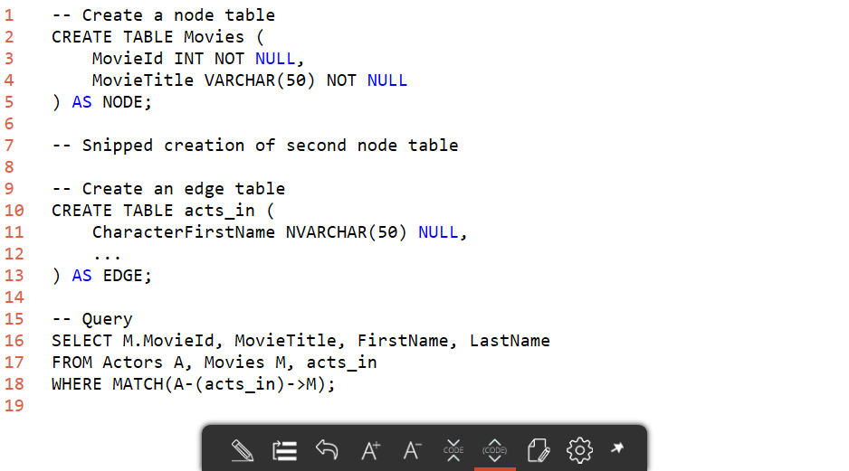
Syntax Summary

Slide 11
Advanced
Tertiary, quaternary, … relationships?
Improve graph performance using columnstore index

Slide 12
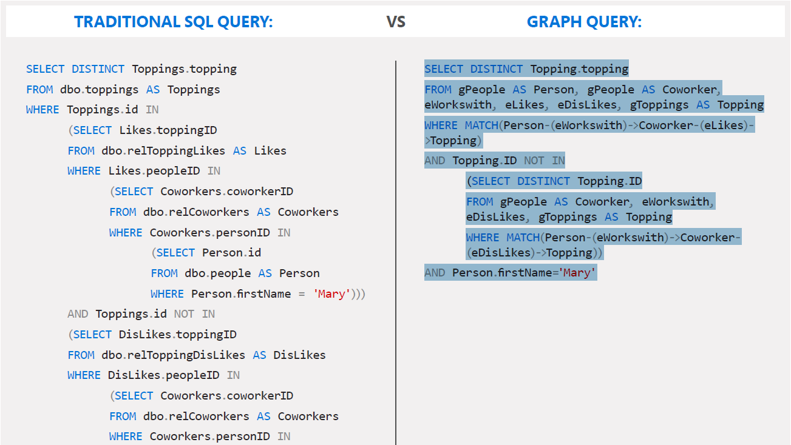
A Microsoft Marketing Sample

Slide 13
Graph Limitations in SQL 2017
Edges cannot be nodes
Cannot update edge to change either node
DELETE and INSERT
No cross-database queries (no PolyBase)
Cannot turn a table into a node
No polymorphism
No transitive closure
No graph analytics functions
Notes:
Polymorphism: ability to find any node connected to a given node (limited workaround: UNION over known relationships)
Transitive closure: ability to follow relationships (limited workaround: recursive CTE or T-SQL loop)
Analytics functions: shortest path, page rank

Slide 14
Further Reading
https://blogs.msdn.microsoft.com/sqlcat/2017/04/21/build-a-recommendation-system-with-the-support-for-graph-data-in-sql-server-2017-and-azure-sql-db/
Large million-row sample
Optimization with columnstore indexes
Visualization of graph with R Services
Itzik Ben-Gan http://sqlmag.com/software-development/puzzle-challenge-graph-matching-t-sql-part-1-concepts

Slide 16
Thank You!
Slides and sample code at
SQL Saturday Sessions page
https://ltr.mn/SSGraph
Contact me at
@svenaelterman
blog.aelterman.com svn@ltr.mn

